Slide 1
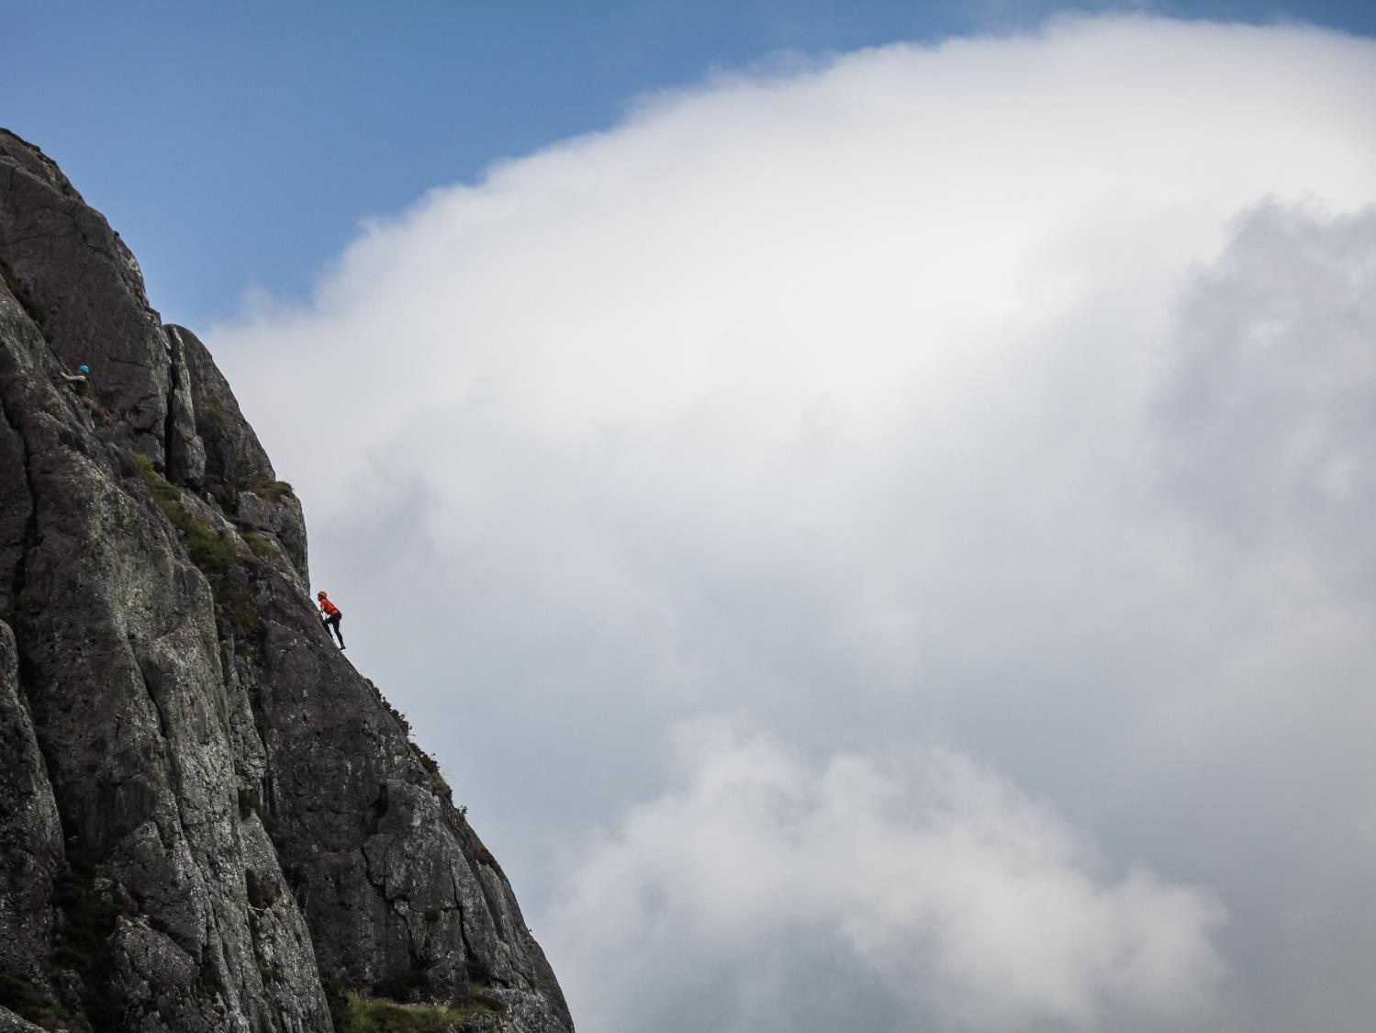

Outward Bound
Helping young people reach new heights since 1941.
The Telford Langley School
8th-12th April 2023

Slide 2
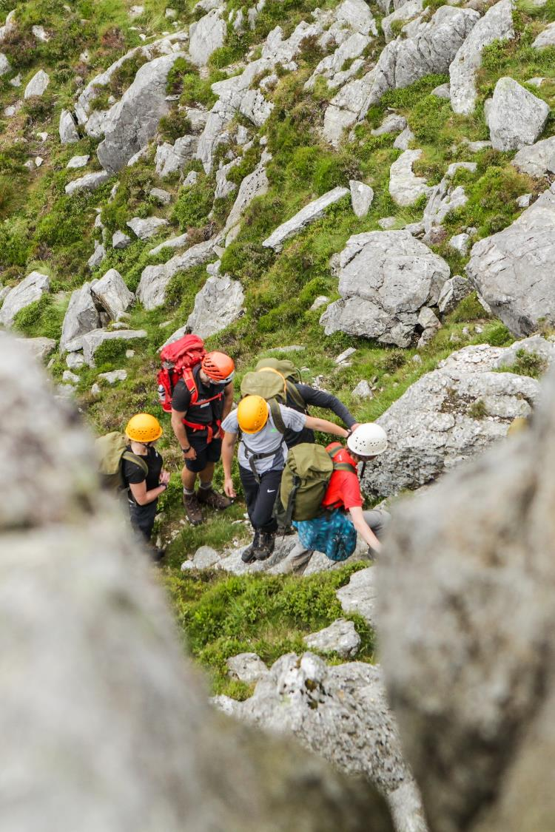
Why Outward Bound?
More than
you
think
The Outward Bound Trust is an educational charity that helps young people defy limitations through learning and adventures in the wild.

Slide 3
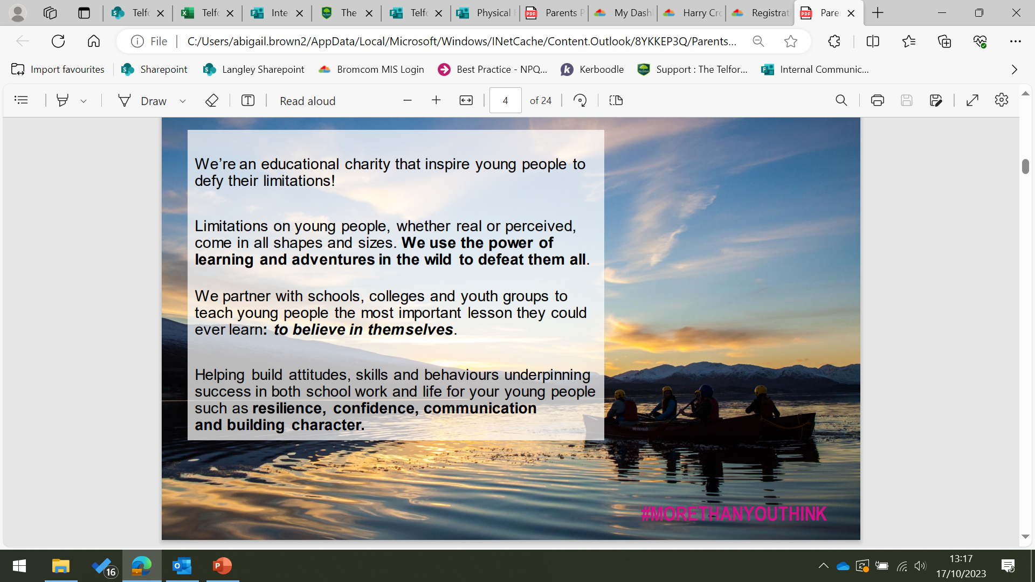

Slide 4
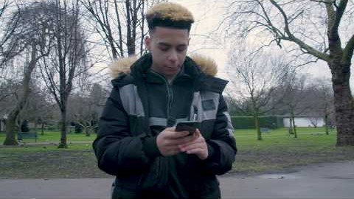

Slide 5
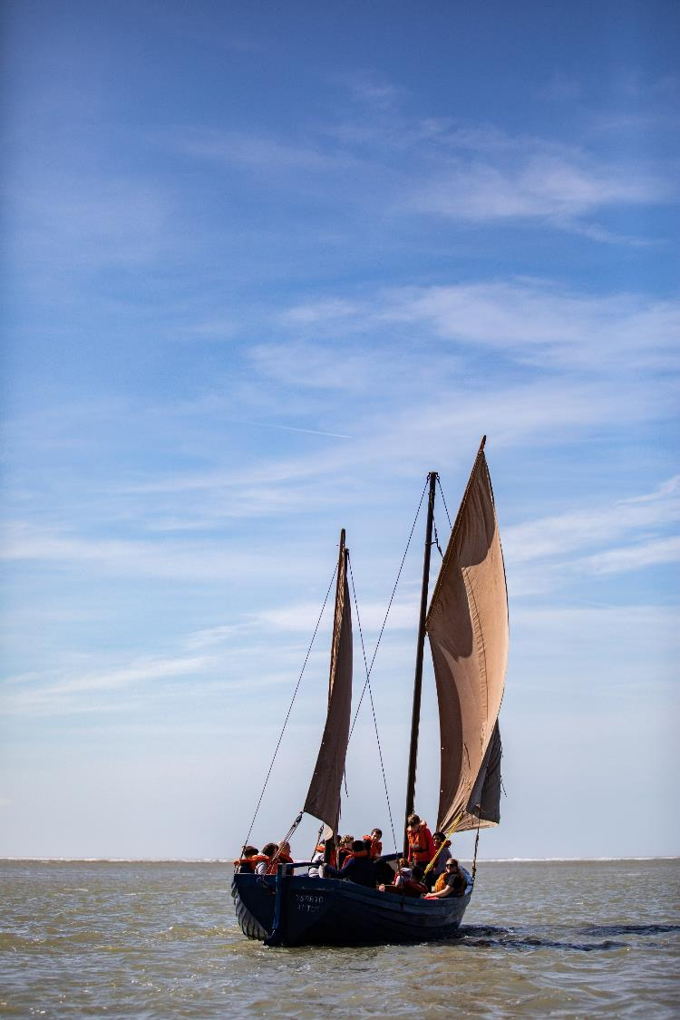
AN ALTERNATIVE
EDUCATION
Outward Bound’s programmes deliver an alternative education, giving young people the skills and confidence to face real world challenges head on.
Creating opportunities for all young people, no matter their background or ability.
Outward Bound work with funders to help remove roadblocks that would otherwise prevent some from taking part and realising their full potential.

Slide 6
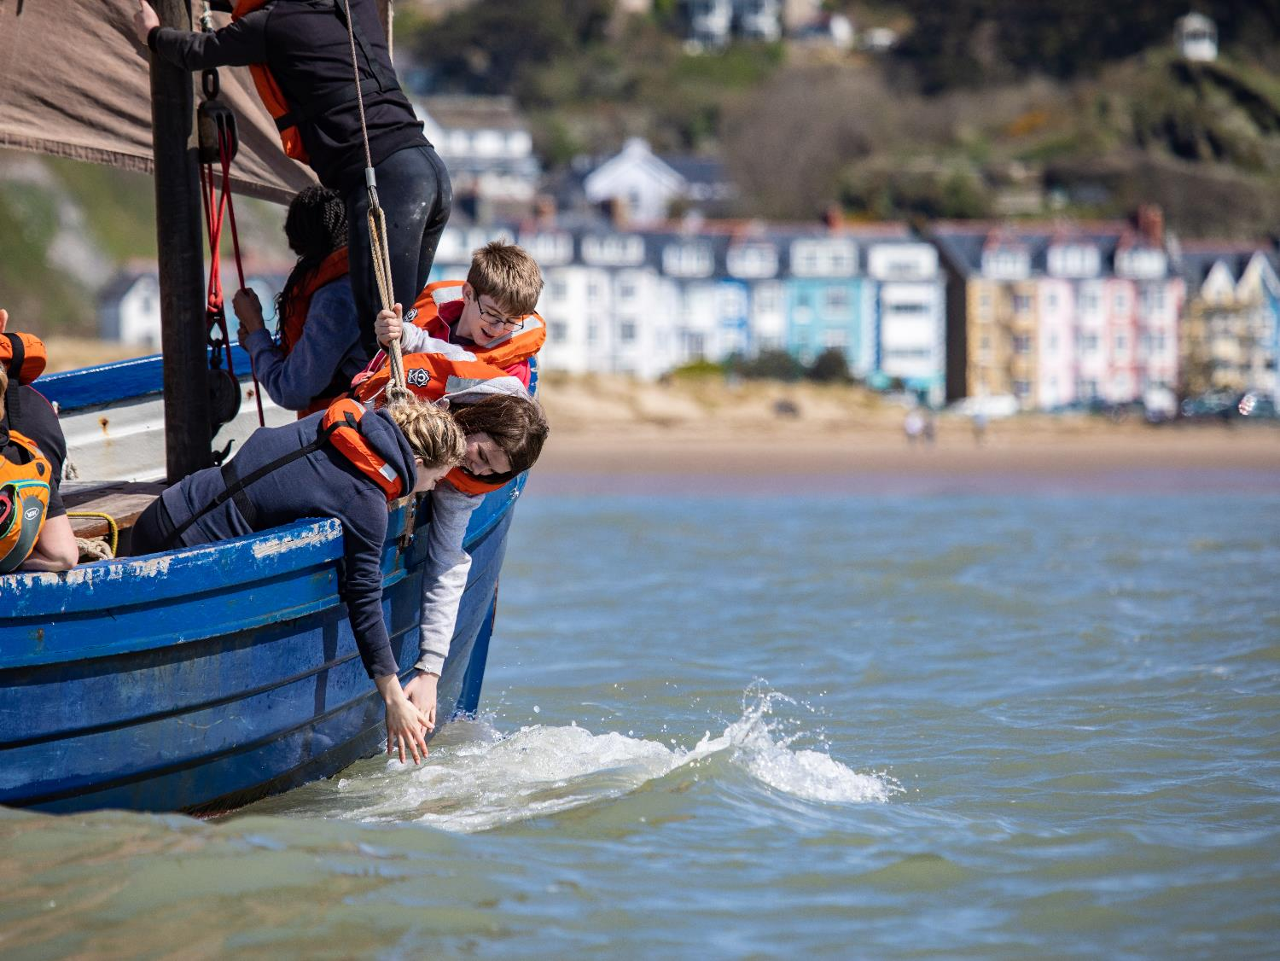
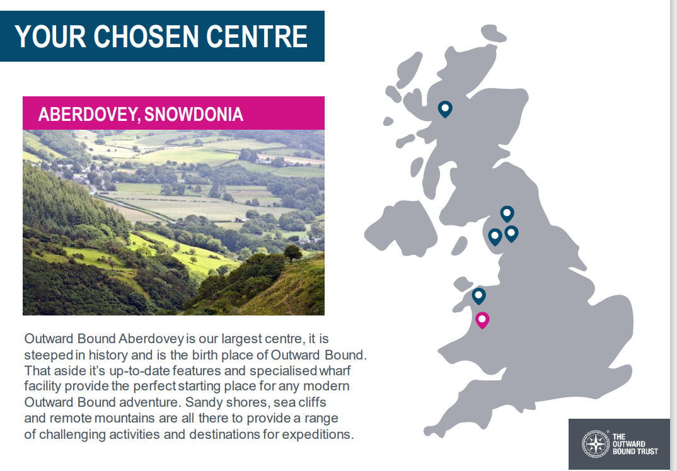
(2) Aberdyfi Centre Tour - YouTube

Slide 7


Slide 8
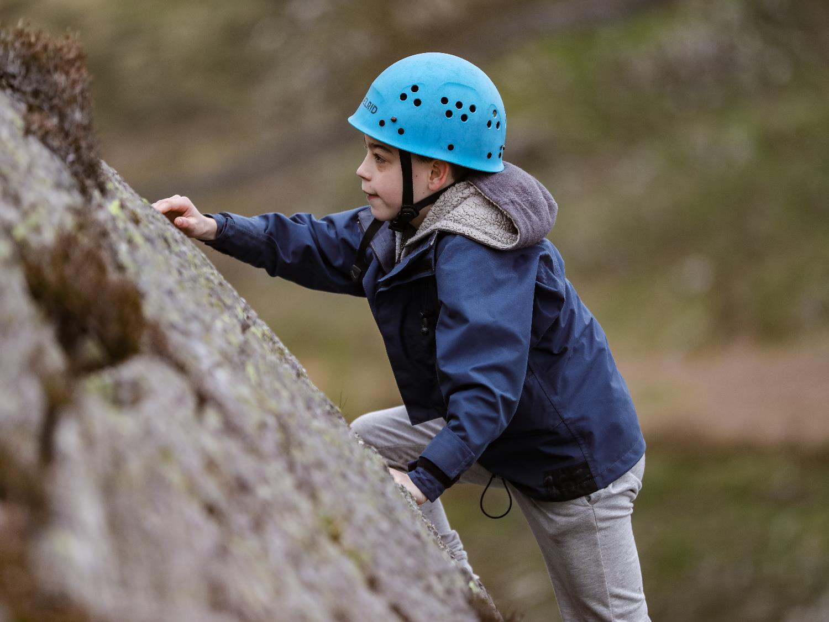
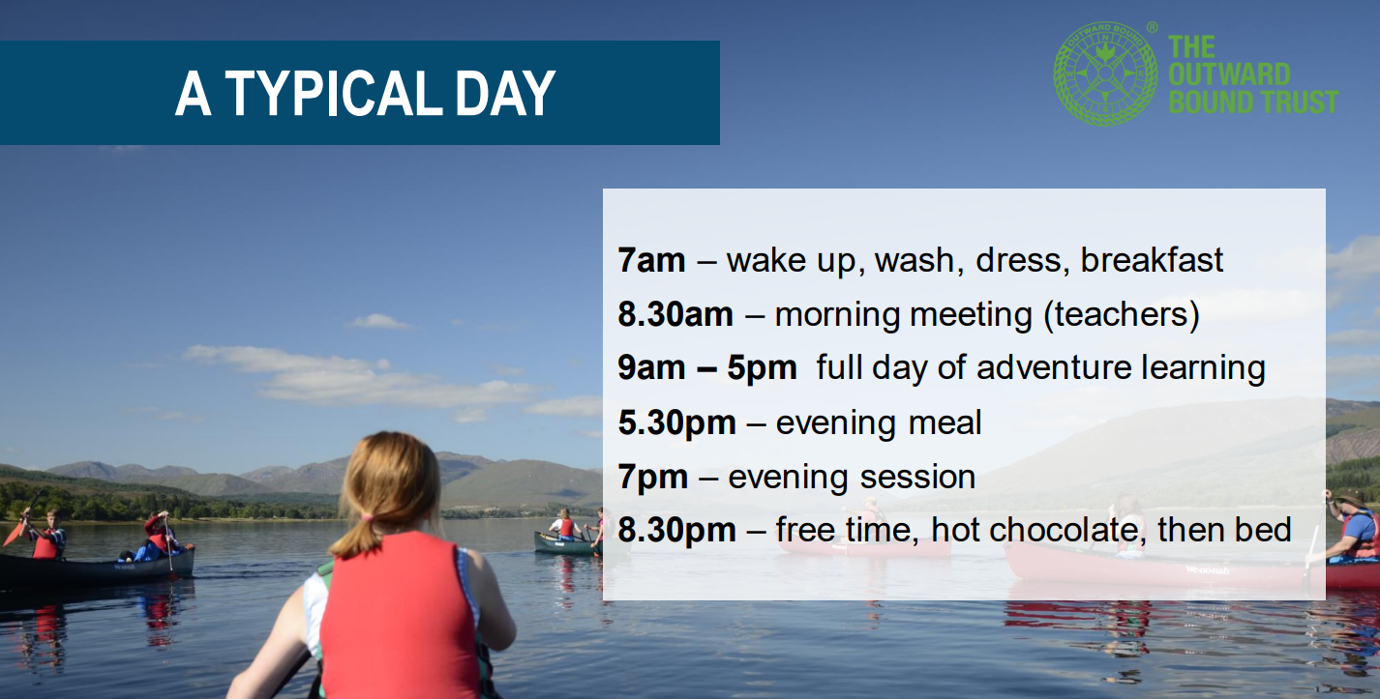

Slide 9
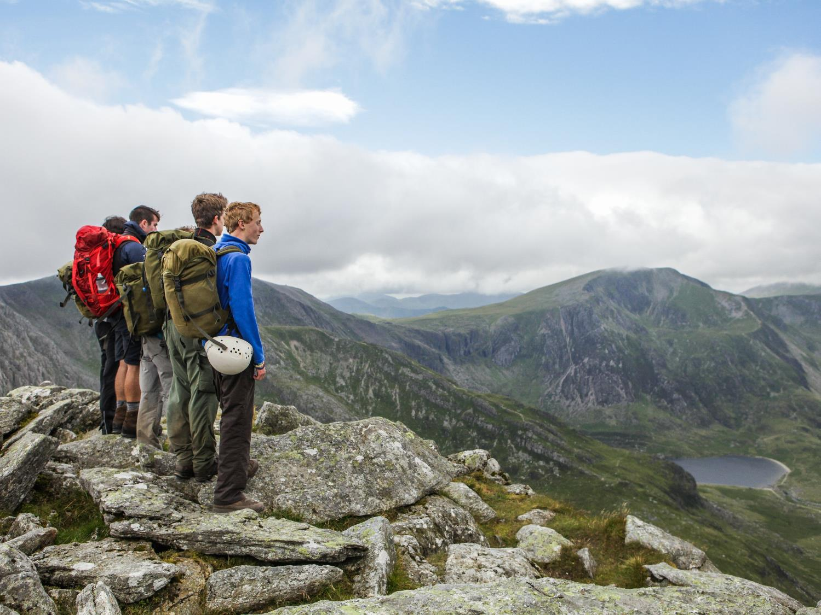
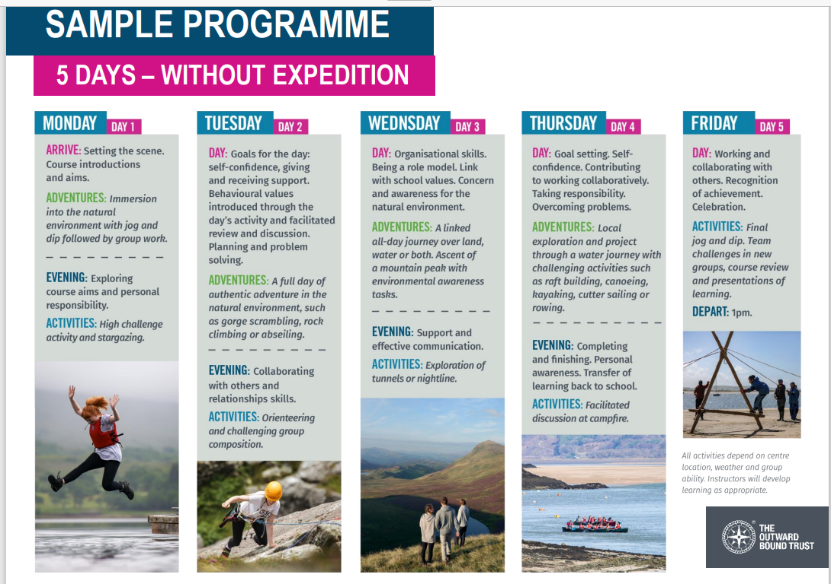

Slide 10
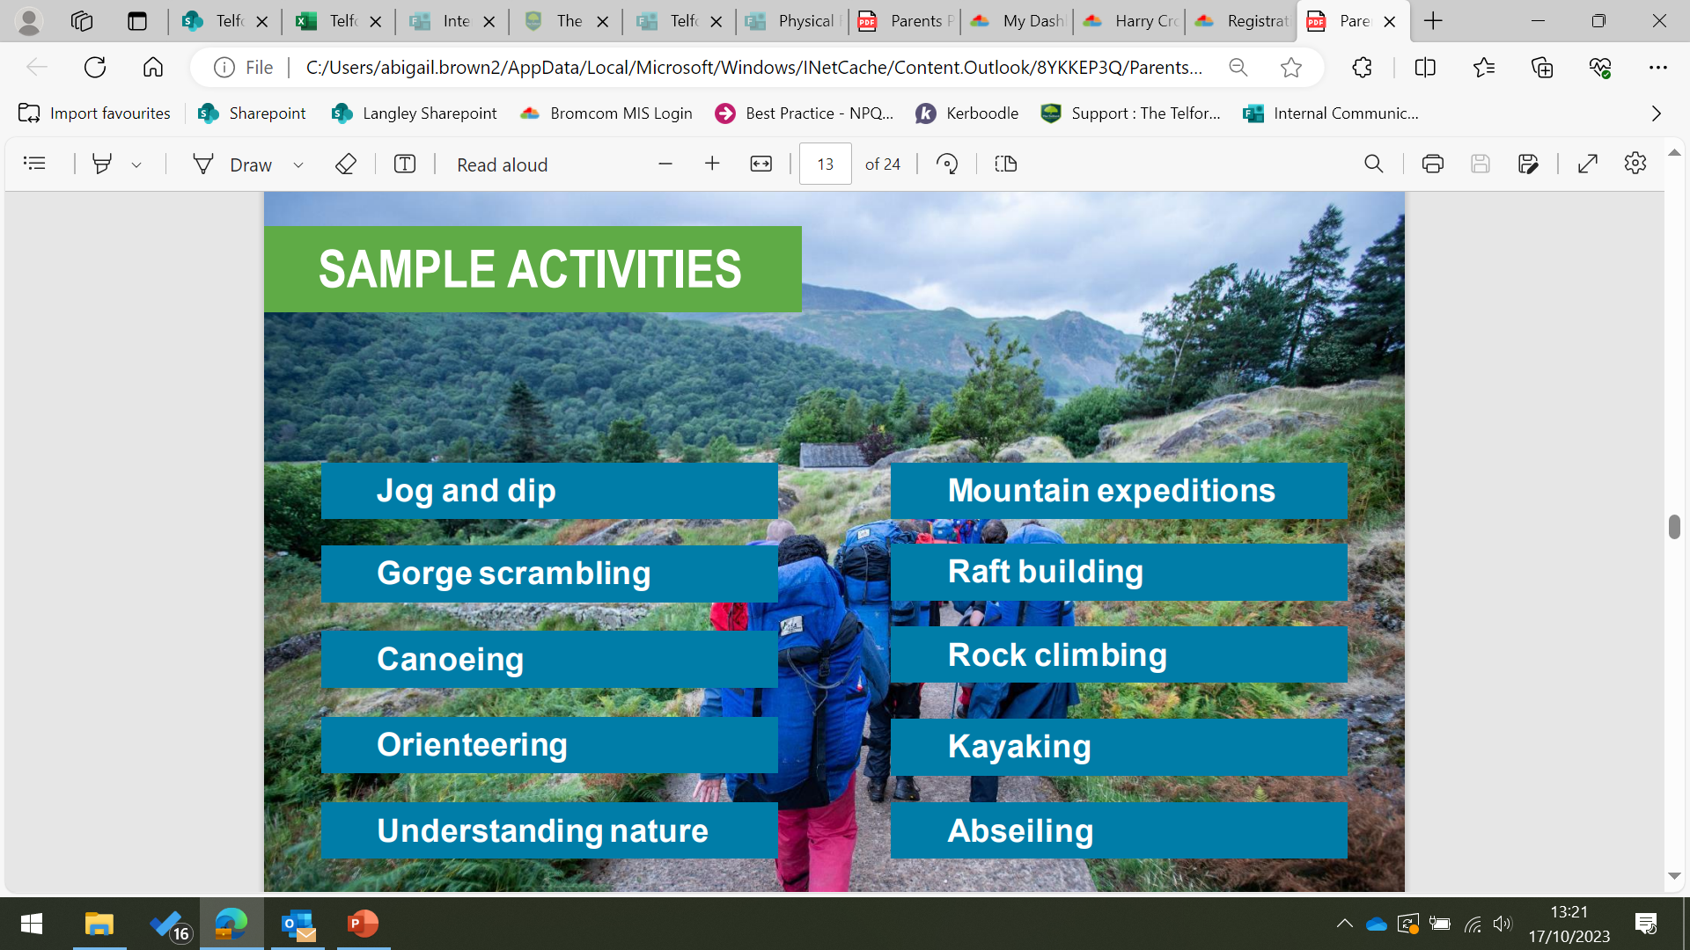

Slide 11
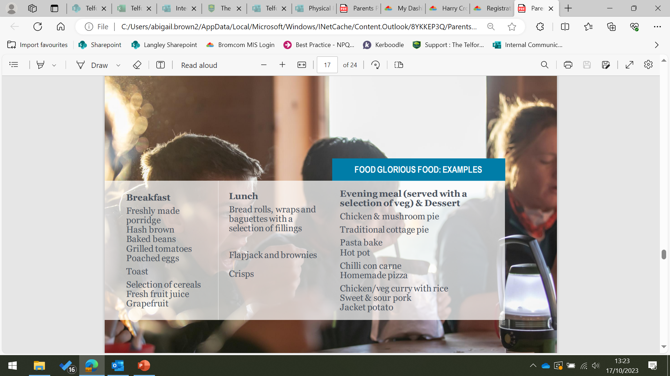

Slide 12
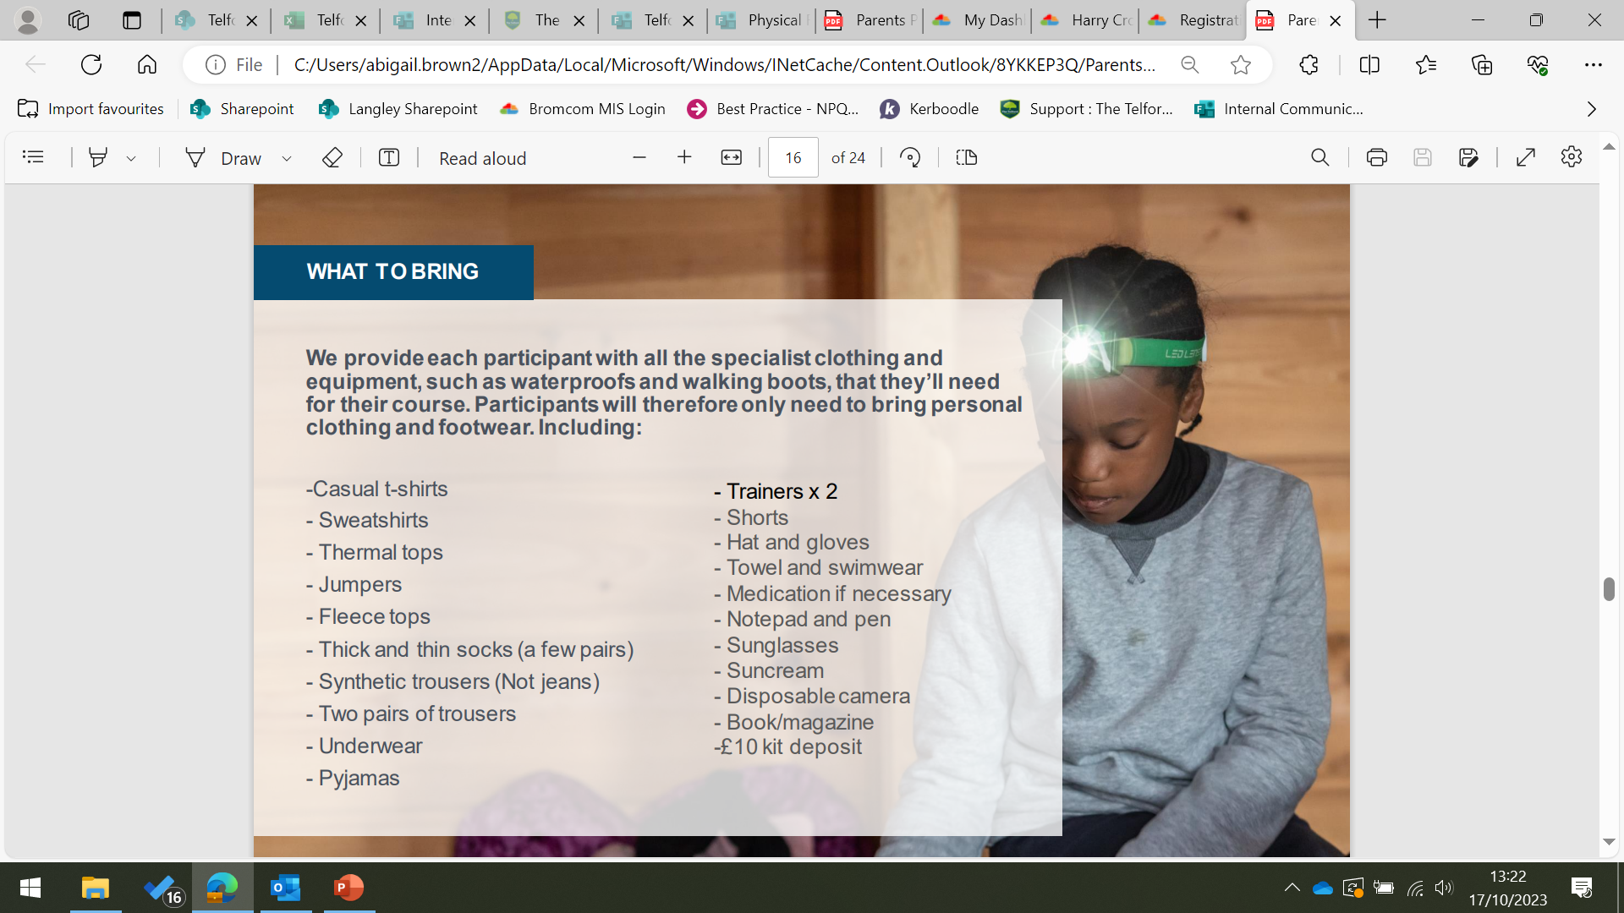

Slide 13
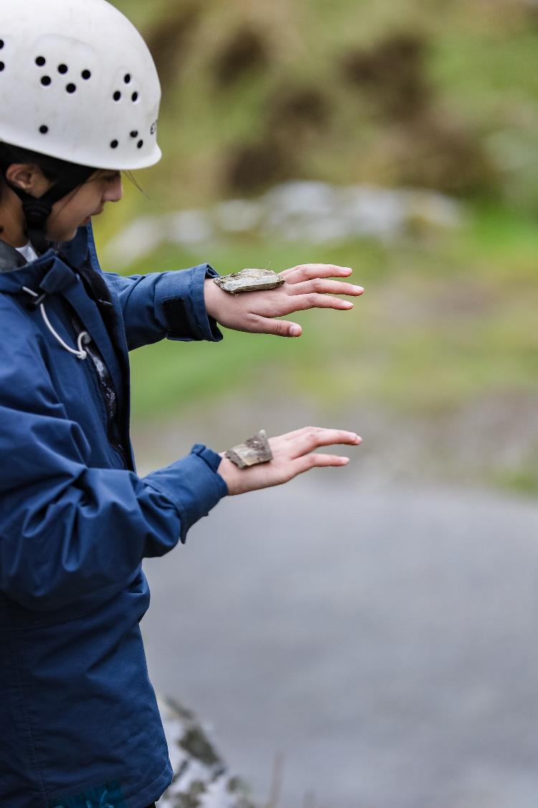
Acclaimed for promoting positivity and confidence, Outward Bound invites young people to scale mental mountains. Because emotional well-being is just as important as physical fitness.
Meaning that when participants returns home, they can say they’ve been transformed into someone they never thought possible.
A different
Kind of
teacher

Slide 14

Ryan’s story

Slide 15
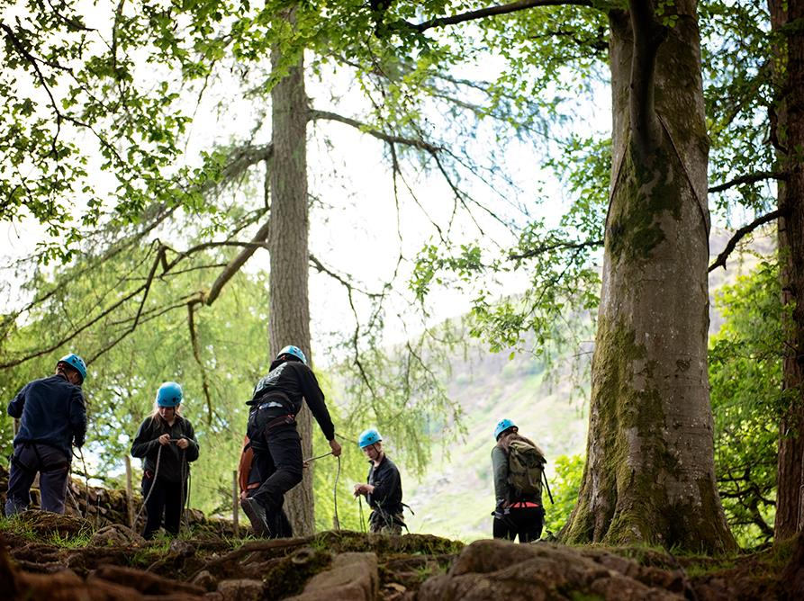
The skills I’ve learned mean that I can and will spend time in the outdoors, but they also make me a better person in everything I do.
Jared, 14

Slide 16
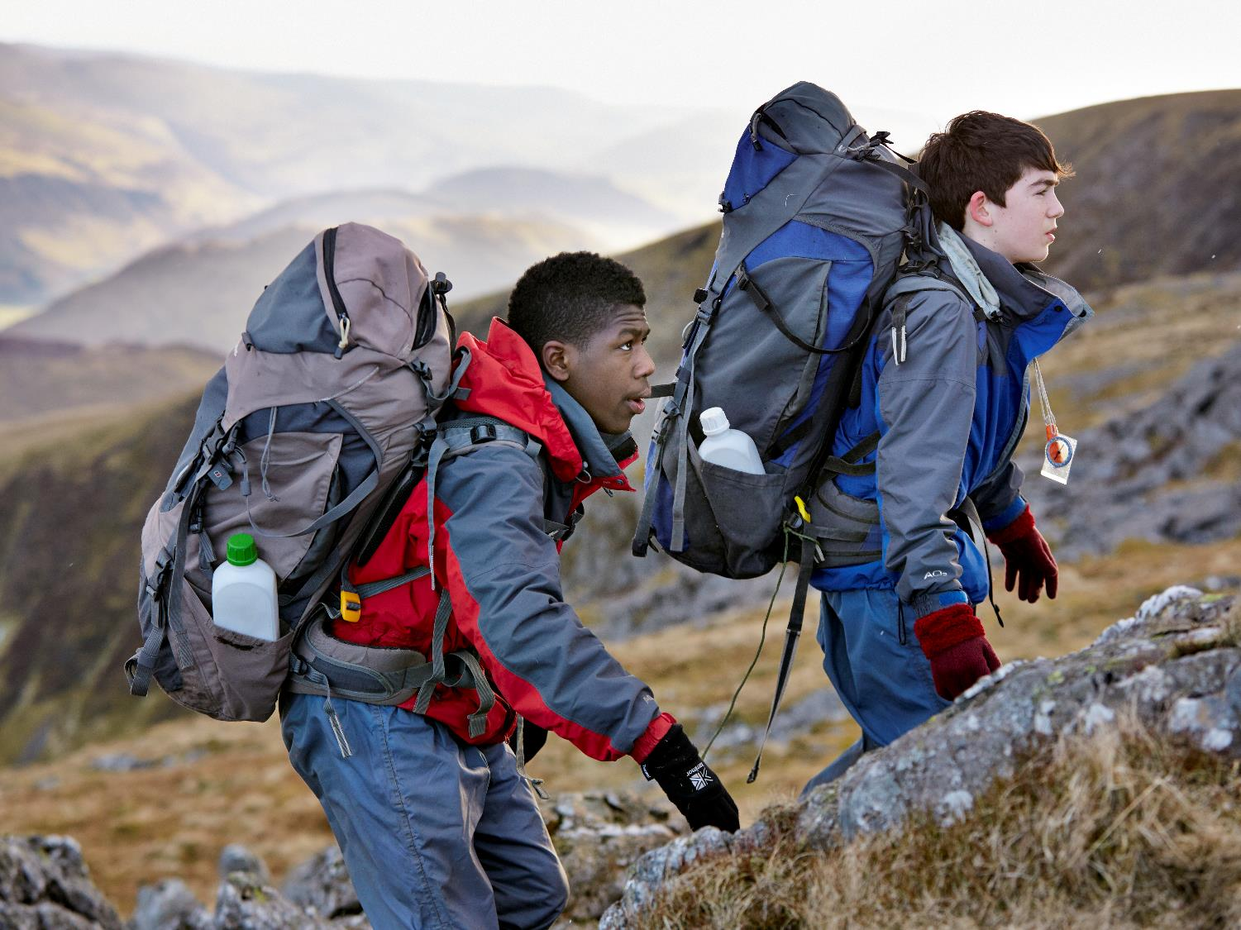
This has given me a new lease of life; it has changed my perception of the world and the way I react to everything.
Oliver, 16

Slide 17

It’s difficult to describe all the emotions you go through at Outward Bound. You feel like a new person when you get back to school.
Rose, 15

Slide 18
The next steps
And Payment
Only 108 places available and first come first serve!
The total cost for the trip including coaches, kit hire and residential is:
£300.
This can be paid monthly or all in one payment.
There will be a £50 Non-refundable deposit to secure your place.
Next step: Fill in consent form attached to the letter and return to Mrs Smith.
Then you will have correspondence from finance to start payment.
Closer to the trip date there will be further information regarding logistics, kit lists etc.

Slide 19
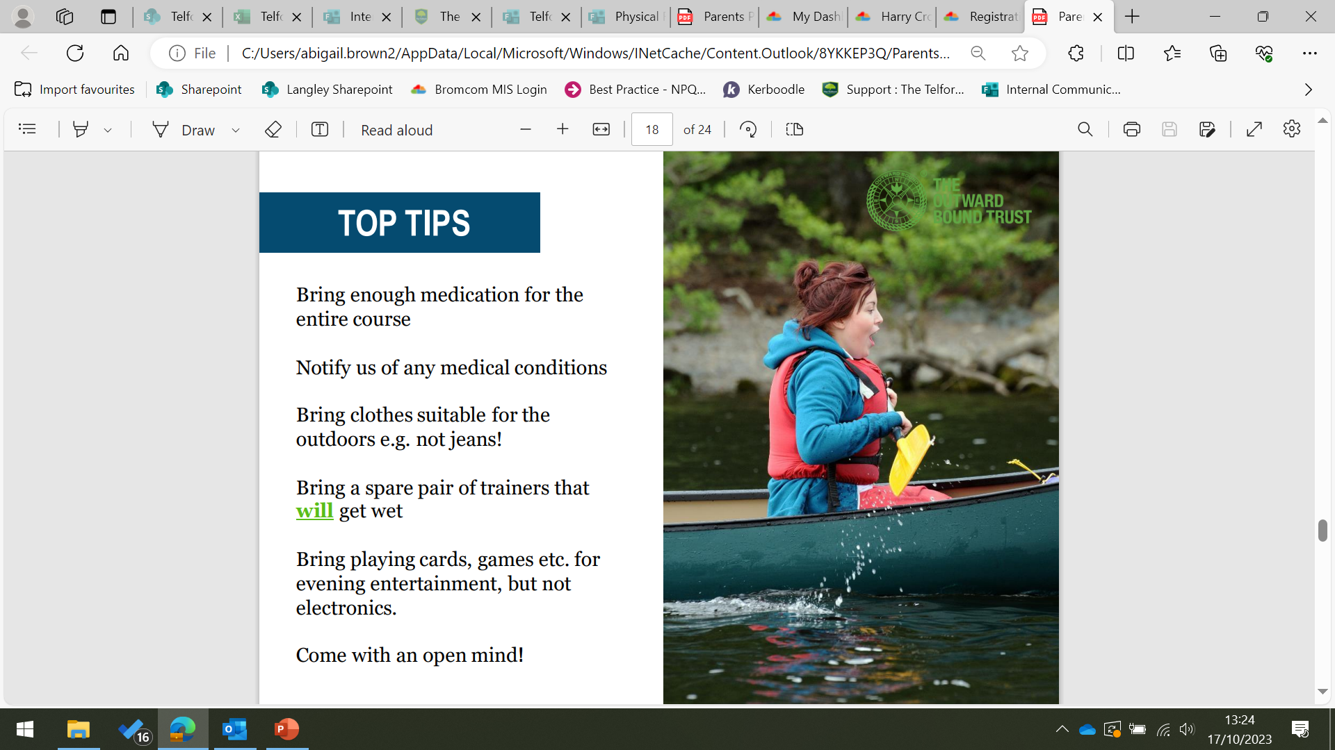

Slide 20
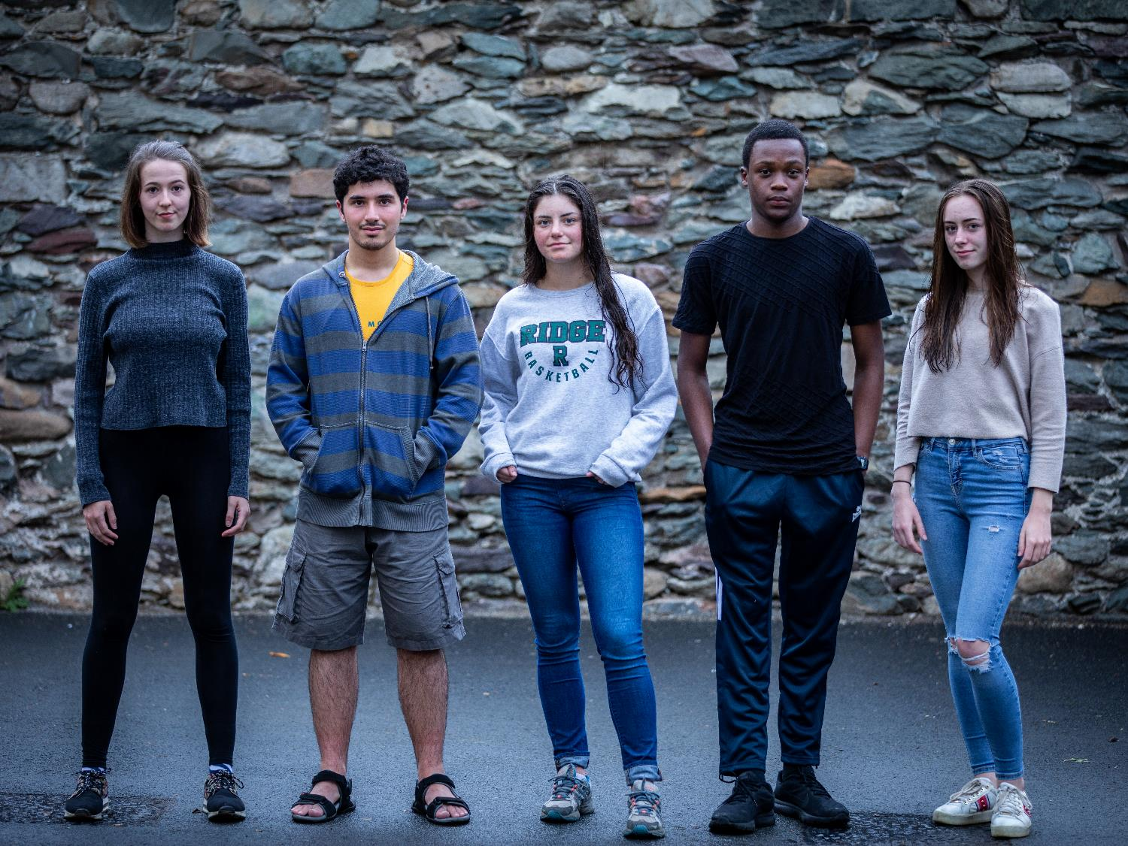
Thank YOU
With your help and support, we can change young people’s lives for the better.
The Telford Langley School

